Slide 1
ImmersiveDeck: A large-scale wireless VR system for multiple users
Interactive Media Systems Group

Slide 2
present preliminary results of work on a low-cost multi-user immersive Virtual Reality system that enables collaborative experiences in large virtual environments
In the proposed setup at least three users can walk and interact freely and untethered in a 200 m² area

Slide 3
INTRODUCTION
several companies (The VOID , Survious, VRcade) provide immersive VR experiences in large physical spaces to multiple users simultaneously, including locomotion by real walking, haptic feedback and the possibility of hand interaction
The potential of immersive multi-user VR is not limited to entertainment. Other application areas include collaborative training, education, behavioural research, collaborative exploration of scientific data, etc

Slide 4
INTRODUCTION
ImmersiveDeck
https://www.youtube.com/watch?v=GqQEl_GICOc
a system where several users can be simultaneously immersed in a virtual environment (VE), explore VEs by real walking and interact with each other in a natural and intuitive way
a low cost flexible multi-user system architecture that incorporates global position tracking, full-body motion tracking, user communication, interaction and tracking of physical objects
Few of VR setups that support real walking features full body tracking or complex multi-user and object interactions before

Slide 5
SYSTEM OVERVIEW
Requirements
The system should implement head and body tracking in a large area
The system should allow voice communication between users
The system should allow collaborative interaction with virtual objects
The system should include the possibility of having haptic feedback while interacting with some virtual objects
The system should support at least three users simultaneously. Therefore, it should implement the distribution of users’ motion and interaction data
Other requirements
Users should be able to move freely
Users should experience as little latency as possible
The cost of the system should be low

Slide 6
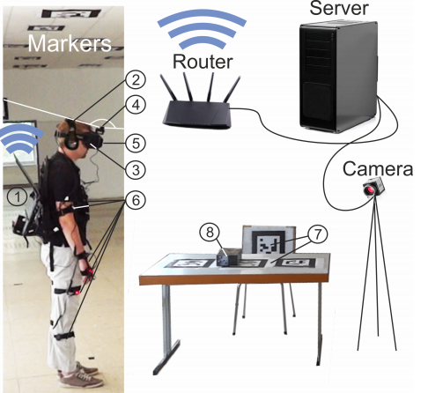
Design
Users are equipped with Oculus Rift DK2 HMDs, motion tracking suits and laptops connected to a server machine over a wireless network. The server runs on a PC with an Intel Core i7 processor
Hardware overview

Slide 7
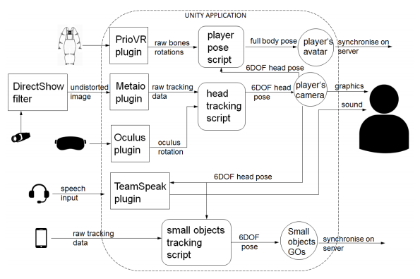
Dataflow in a client application

Slide 8
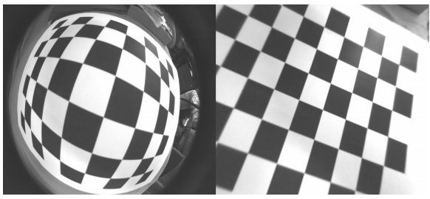
USER TRACKING
Head Tracking
Image Undistortion and Lens Calibration
Fish-eye lenses are used to produce very wide angle images, use undistortion algorithm
calibration parameters are applied at runtime by the Metaio tracking process directly
Results of the lens undistortion algorithm

Slide 9
Body Tracking
use the beta version of the PrioVR motion capture suit. A suit consists of 11 inertial sensors placed on a user’s limbs which are connected to a hub on the user’s chest
In the beginning of each VR session, each suit needs to be calibrated

Slide 10
OBJECT TRACKING
In this system, users can have haptic feedback while interacting with some of the virtual objects present in the scene, achieve this by having real objects tracked in the real environment and overlaying them with virtual representations
Big Object Tracking
use multi-marker tracking
Several fiducial markers are attached to the table and the chair and are tracked by a camera connected to the server machine
Mobile Tracking of Small Objects
The tracking of smaller objects is implemented locally with an Android smartphone mounted on a user’s Oculus Rift

Slide 11
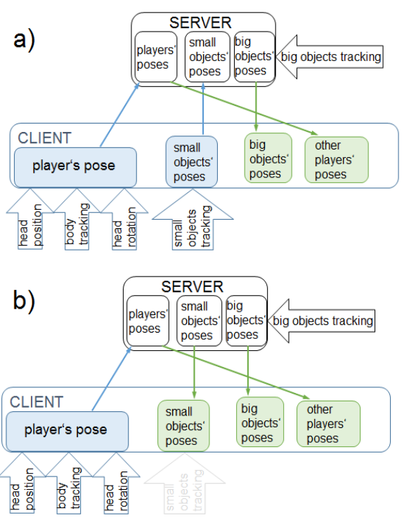
(a): Mobile tracking of small objects is active on the client. In this case, the client application sets up poses of corresponding GameObjects. The poses of the server copies of these GameObjects are synchronised. (b): When the client application is not tracking small GameObjects, their poses are synchronised from the server. All synchronisation is done via UDP
Data exchange between the server and a client

Slide 12
DISCUSSION
Technical limitations
The update rate of a laptop working on battery power is currently the biggest technical limitation
Free movement
This setup allows users to freely perform large range of movements
Latency
interactions between users and collaborative interaction with virtual objects do not reveal obvious latency between haptic feedback and graphics
Scalability
In terms of the size of the tracking area, the system is only limited by the amount of ID markers that can be used for tracking and the coverage range of the router
Invasivity
the overall weight of the equipment worn by each user is 7.4 kg, looking into more ergonomic ways of carrying the laptop, expect that future generations of laptops or mobile devices with similar computational capabilities will provide a smaller form-factor

